Slide 1
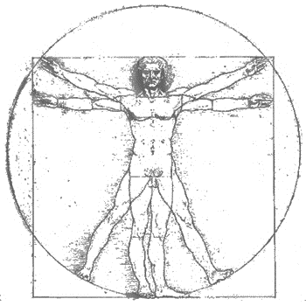
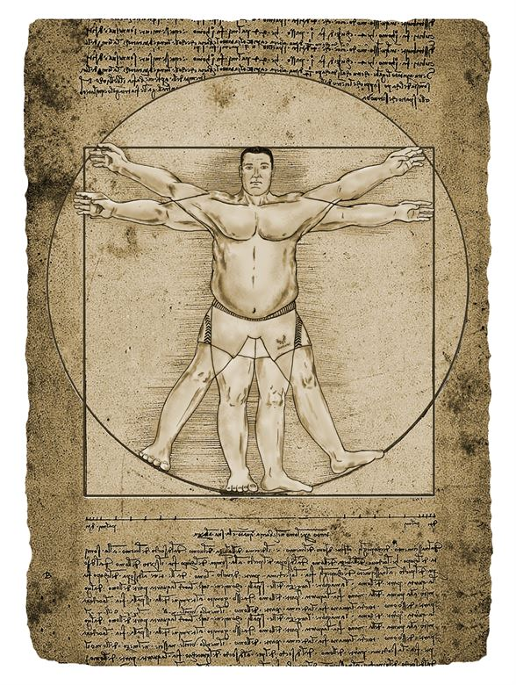
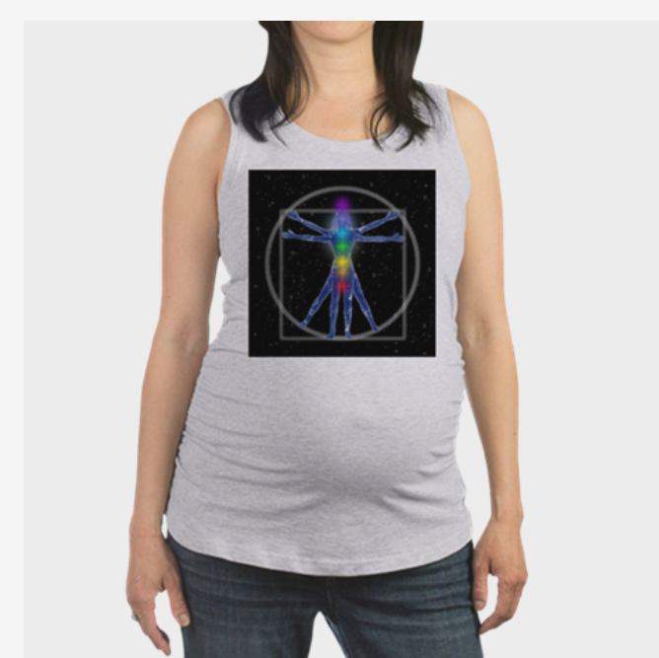
HuBMAP CCF Workshop: Kidney-Focus Discussion,
May 9, 2019
In search of the human body’s Common Coordinate Framework (CCF) …
Evaluating The Vasculature as CCF
(Road Map for the Human Body “Google Map”?)
Zorina Galis, PhD, NIH/NHLBI
A 'Growing' Problem - Obesity a concern for veterans, recruits and kids
https://www.cafepress.com
Note: The opinions presented do not necessarily represent the NIH opinions

Slide 2
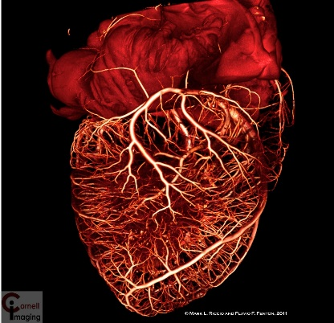
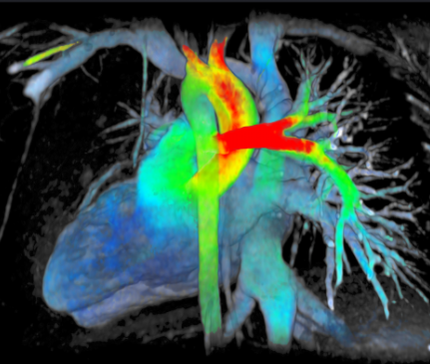
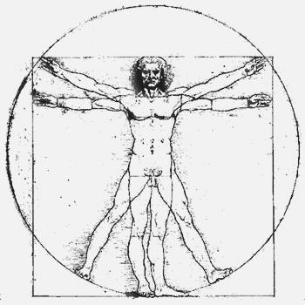
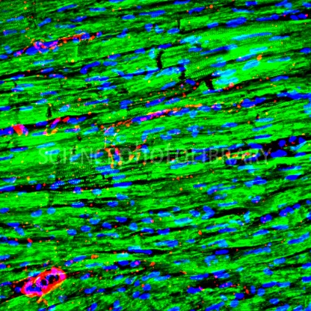
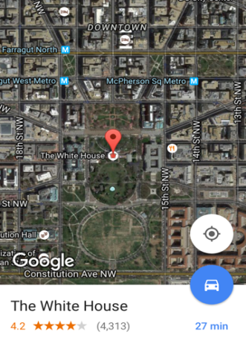
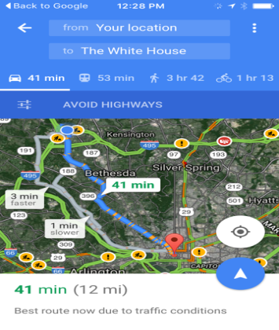

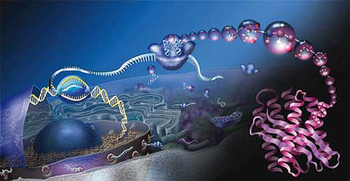
Evolution Of Human Body Investigations
NIH Common Fund Proposals Final Audition, December 14, 2015
Whole body/organ analysis
Macroscale
Phenotype
Tissue level
GEViosWorks
A “Google Map” of the Human Vasculature?
INVESTIGATION RESOLUTION
Mesoscale
OBSERVED SCALE
Single Cell analysis
Genotype
BICK & POINDEXTER, UT MED/SCIENCE PHOTO LIBRARY
Microscale
Photo: National Science Foundation

Slide 3
Content
Summary of previously identified desirable CCF characteristics (NIH-CZI CCF meeting, Dec 2017)
Proposing the vascular system as CCF for the entire body map
How could vasculature support these “desirable” CCF characteristics?
Focus on Kidney:
Potential to incorporate and test utility of vasculature for kidney mapping
Other organs?
Work in Progress

Slide 4
Evaluating Utility of the Vascular System
Desirable Features for a Body CCF
CCF meeting CZI-NIH (Dec 2017)
Works across several scales (cell <> tissue <> body)
Applicable to all (most) body tissues
Accounts for donor differences (e.g., size, shape, sex)
Useful/Acceptable across specialty domains

Slide 5
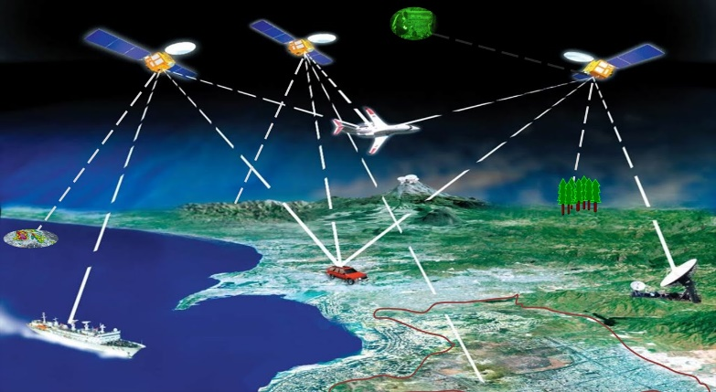
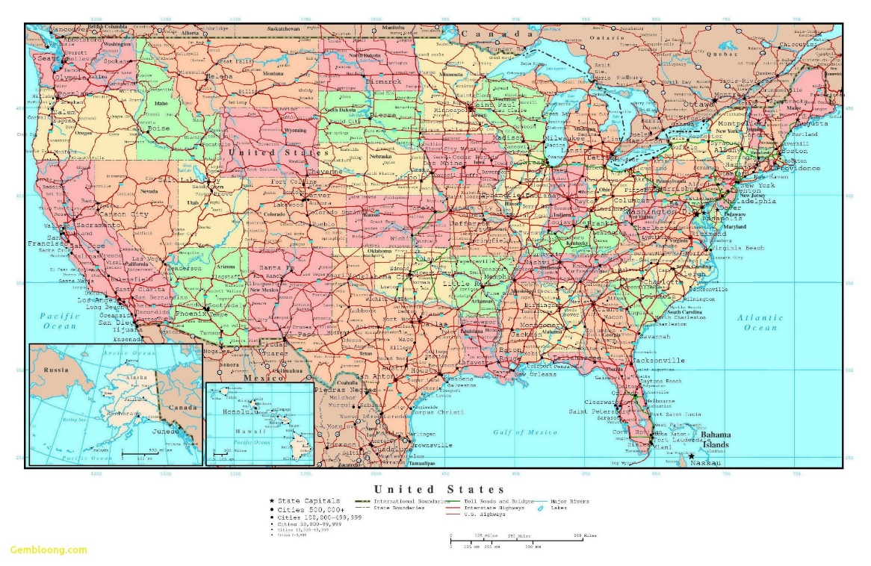
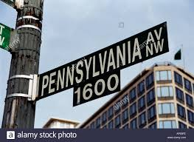
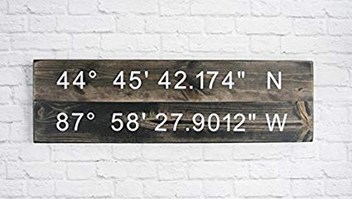
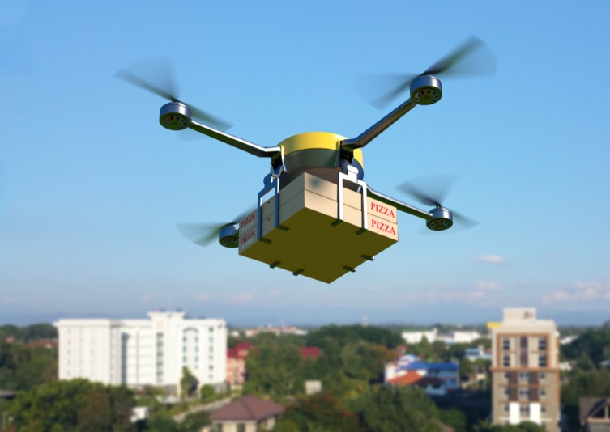

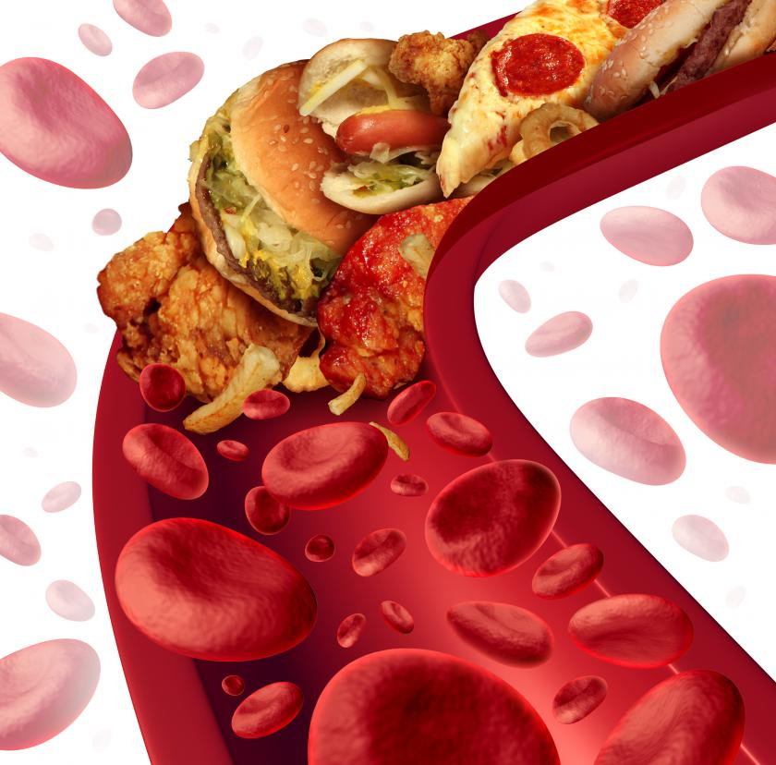
Many Ways to Identify and Reach a Specific Location….
The human body already uses a precise delivery system…
https://www.pymnts.com/intelligence-of-things/2018/drone-delivery-mobile-orders-flytrex-ncdot-holly-springs/
https://www.medicaldaily.com/eating-out-hurts-your-heart-health5-little-known-causes-high-blood-pressure-329006

Slide 6
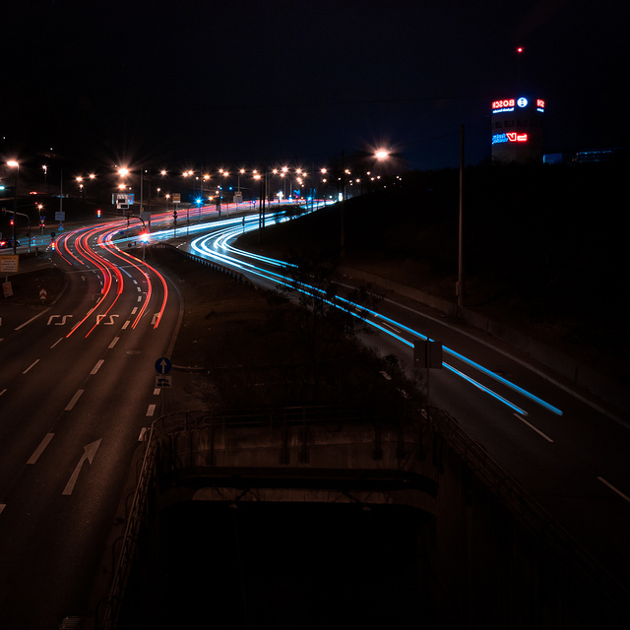
The Vascular System as Human Body CCF (and Road Map for the Body)
Anatomically relevant: vasculature is connecting, reaching out and delivering oxygen to every organ, tissue, and single cell. An empirical estimate: maximum distance from any cell to the closest blood vessel (source of oxygen) ~100 um
Seamlessly tapers down across scales, from macro (whole body/clinical) > mesoscale > microscale. Macroscale: 50-100 K miles of blood and lymphatic vessels, microscale: single cell-size vessels (= capillaries)
The vascular system is adapted to individual body size and shape (accounts for interindividual variations), “normal variations” do not have phenotypic implications
Already used clinically to localize, access and target tissues, diagnose, treat organs and tissues in a variety of diseases and procedures (planning surgeries, biopsies, delivery of devices and treatments, etc.)

Slide 7
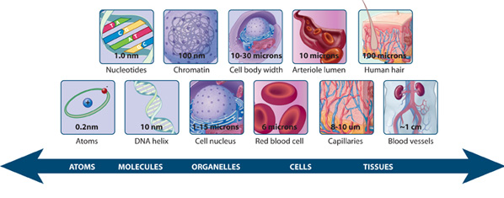
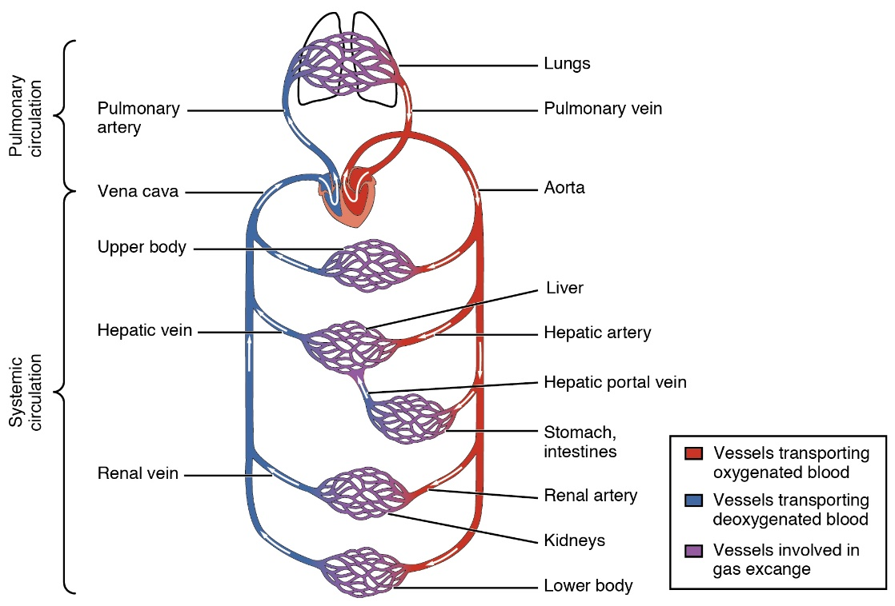
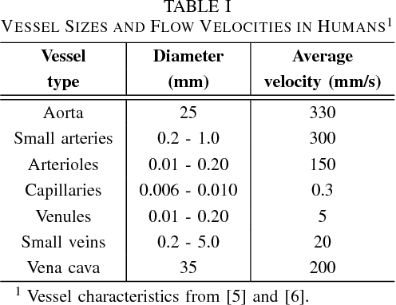
Desirable # 1: “Works across several scales (cell <> tissue <> whole body)” Blood Vessels Go (Seamlessly!) Across Scales Macro<>meso<>micro
Vasculature reaches within and integrates every and all body tissues and organs
https://www.nature.com/scitable/ebooks/essentials-of-cell-biology-14749010/118237871
https://en.wikipedia.org/wiki/Circulatory_system#/media/File:2101_Blood_Flow_Through_the_Heart.jpg

Slide 8
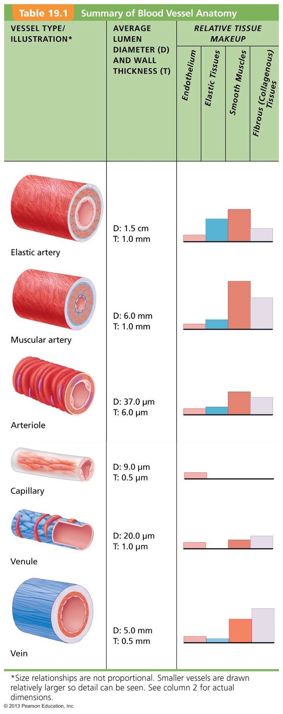
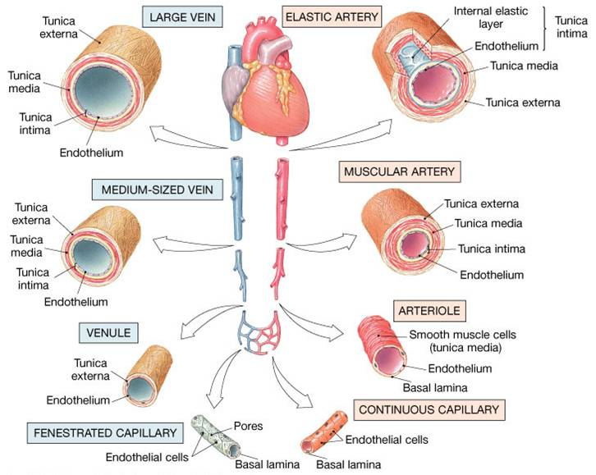
Seamlessly Integrated Across Body Scales Types And Sizes Of Various Blood Vessels
MACRO
(body/organ)
https://kylecollinsbiology.weebly.com/biology-i.html
The endothelial layer (cells lining ALL vessels) is contiguous throughout the body
Aorta is the main artery https://radiopaedia.org/articles/aorta?lang=us
Meso<>Micro
(tissue/single cell)

Slide 9
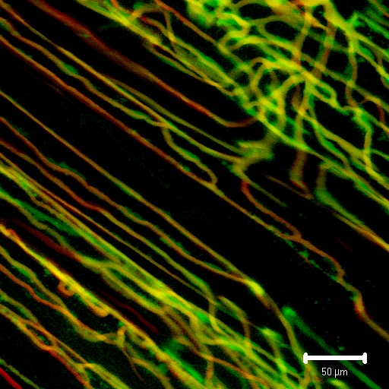
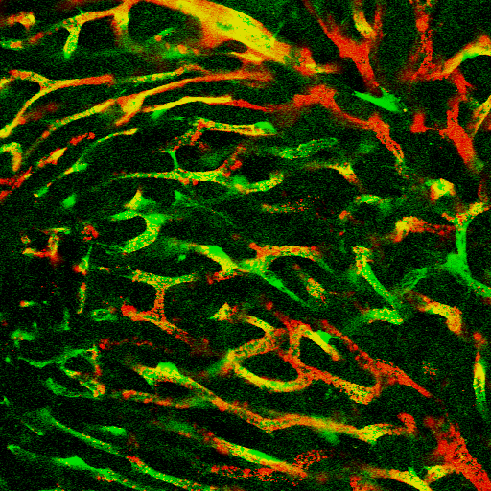
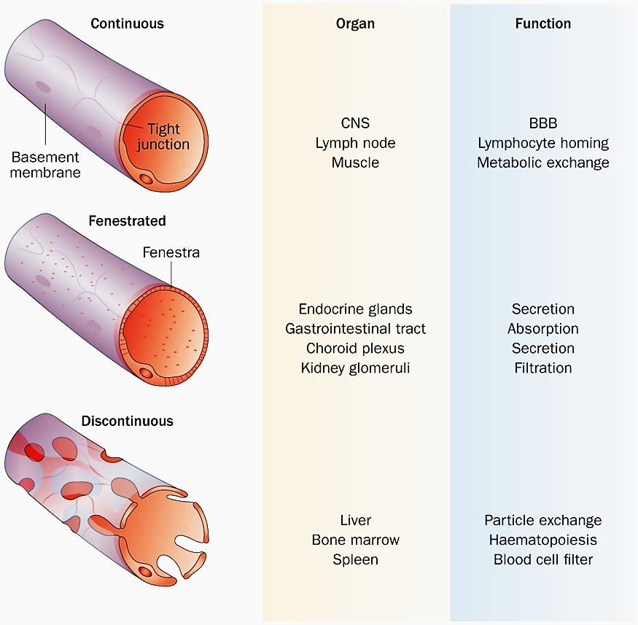
Meso <> Micro Level Integration of Vasculature Within Tissues
Endothelial Cells (EC) As The Gate-keepers of Tissue Level Interaction/Exchanges
Local Vascular Structural & Functional Diversity
“Continuous EC“ (Muscle)
“Discontinuous EC” (Liver)
Tissue/Cell level
Small Blood Vessel-Tissue Exchanges:
Endothelial cells (Tie-2 GFP), Perfused Microbeads
(Galis & Johnson)
200 μm

Slide 10
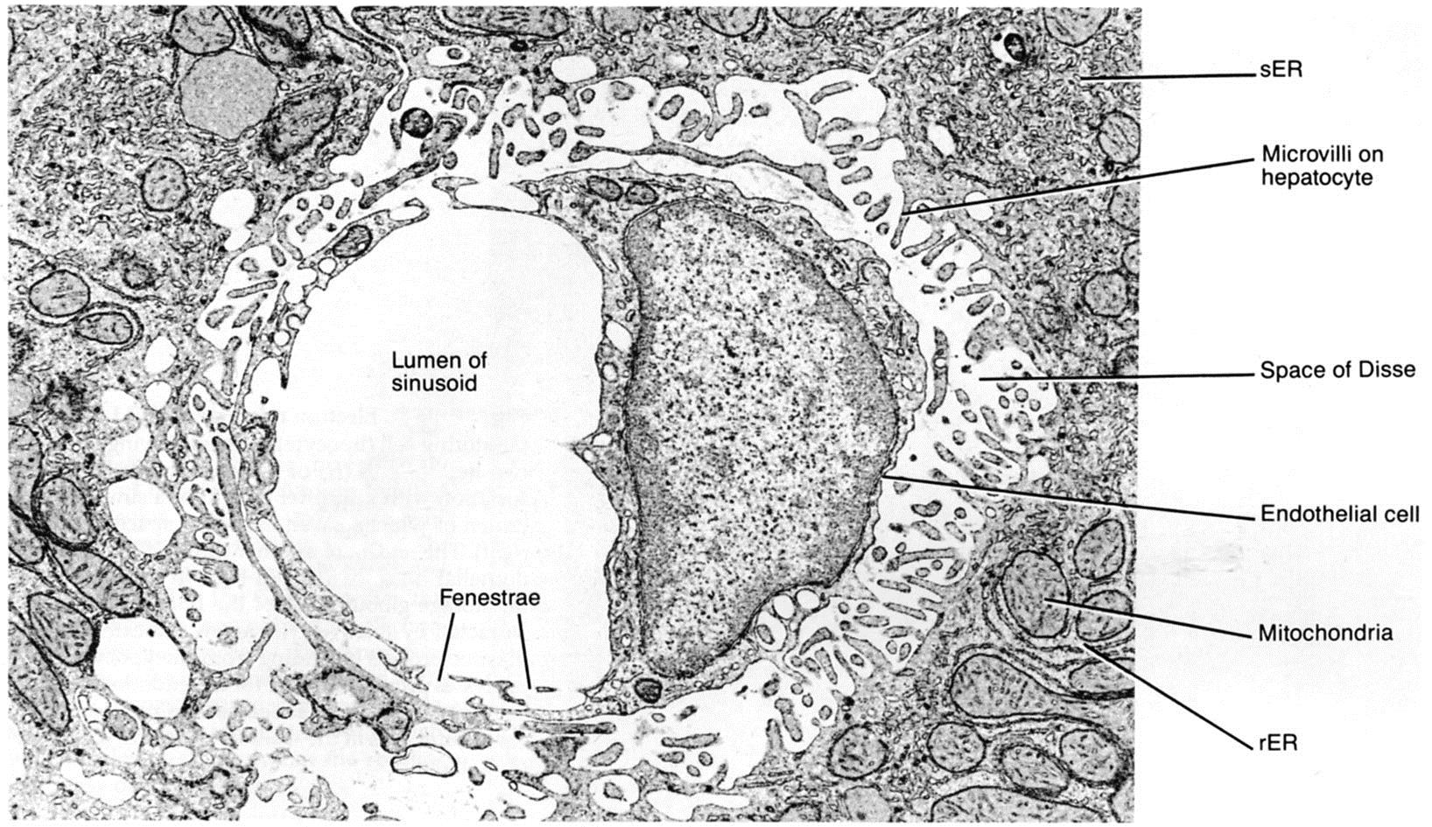
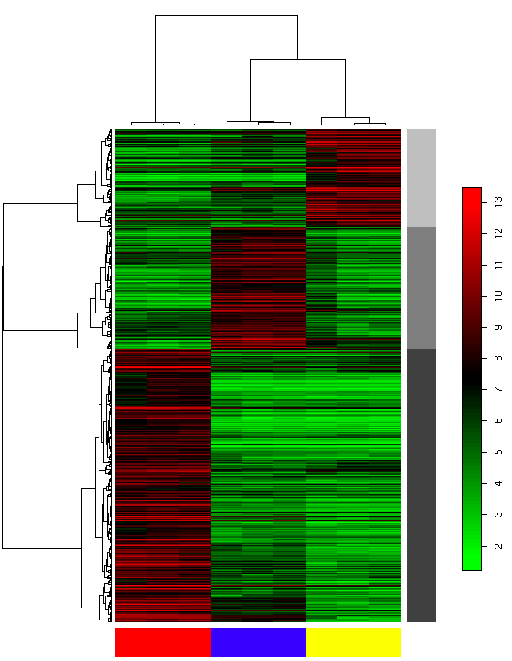
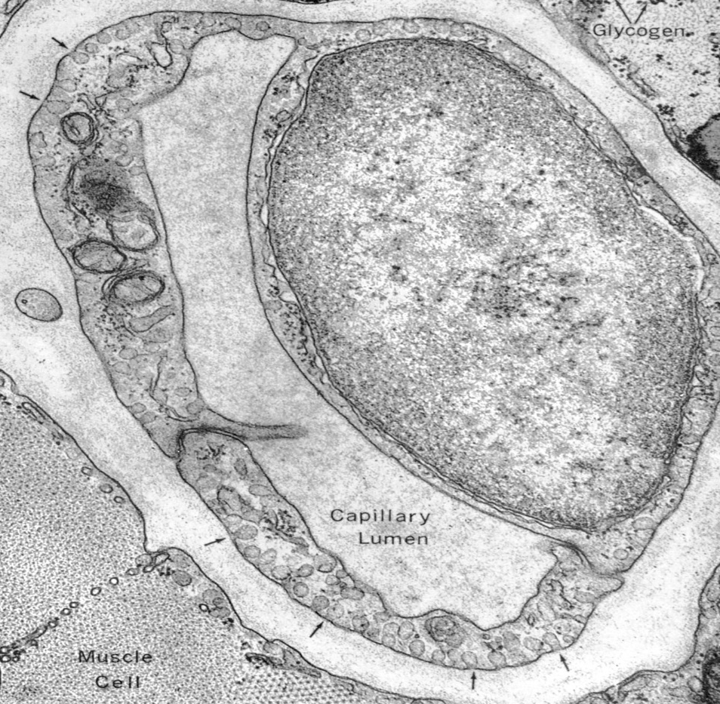
Microscale: Vascular – Tissue Interactions at Single Cell Level
EC Unifying Principle (in all tissues) with Local Structural/Functional Diversity
Local/Organ Variations of Capillaries (the smallest blood vessels = single cell layer thick)
“Continuous EC“ (Muscle)
“Discontinuous EC” (Liver)
Molecular level:
Organ-specific diversity of endothelium
Heat Map expression of organ-specific endothelial genes (Dr. Eng H. Lo)
Cellular level
EC Nucleus
Brain Heart Kidney

Slide 11
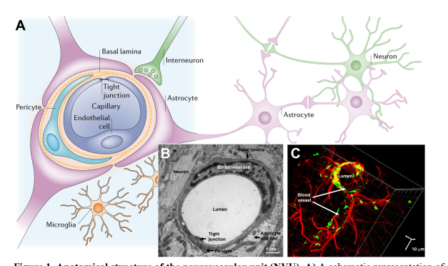
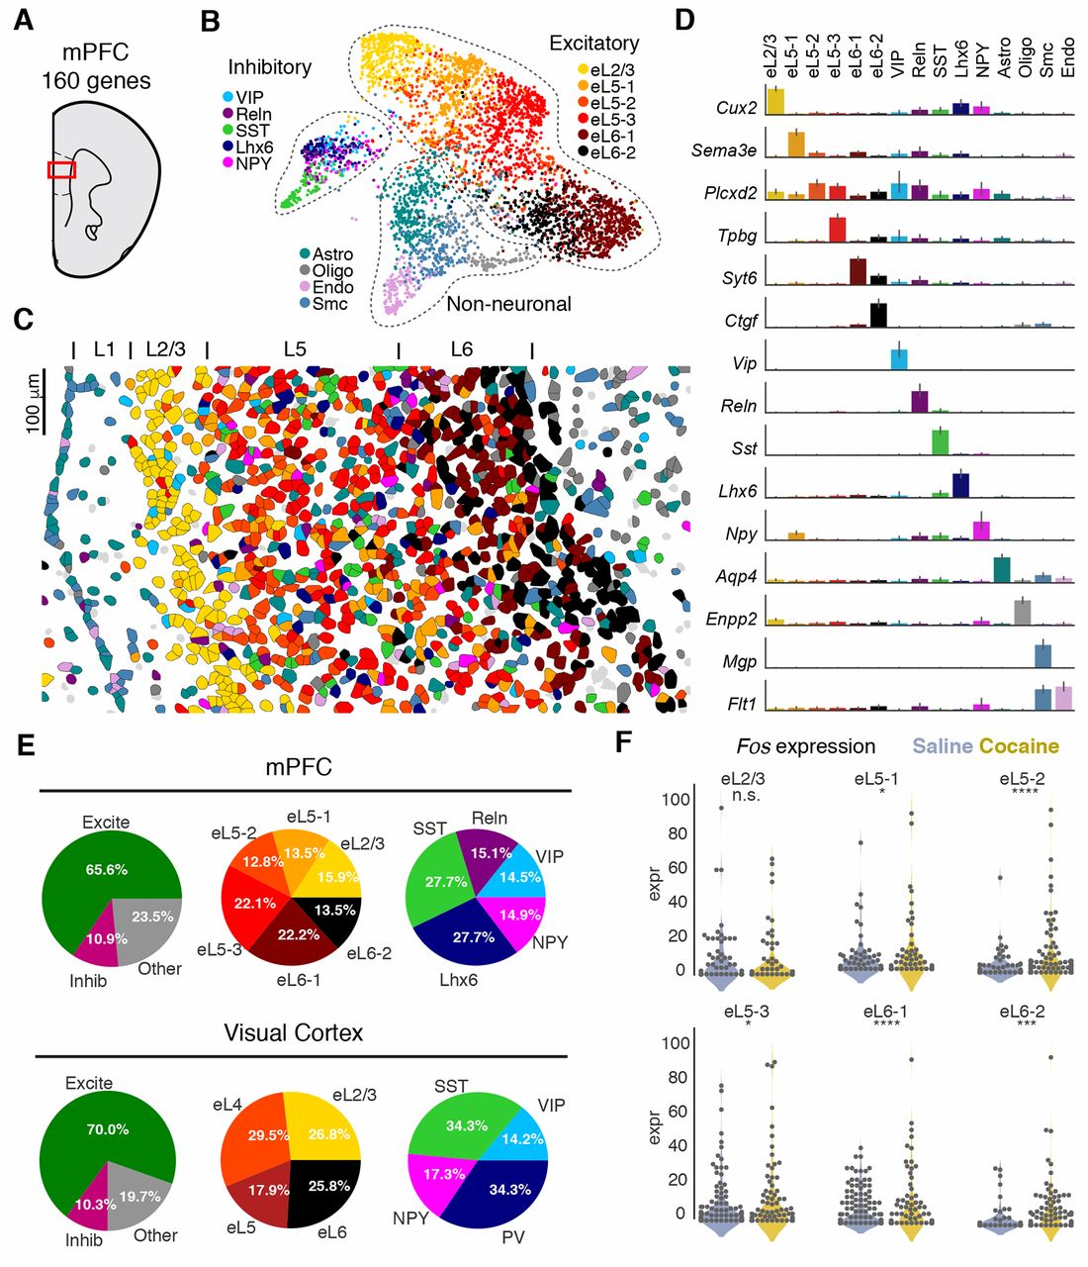
Vascular Single Cell Level Integration in Tissues Example: The Brain Neurovascular Unit
The Translational Significance of the Neurovascular Unit: A Mini-Review, McConnell et al, 2016 JCI
Brain Mapping by Cell Type (STARmapping)
Wang et al, Science 21 Jun 2018
A single endothelial cell = blood vessel (capillary) is at the center of the neurovascular unit
Blood vessels are everywhere in the tissue

Slide 12
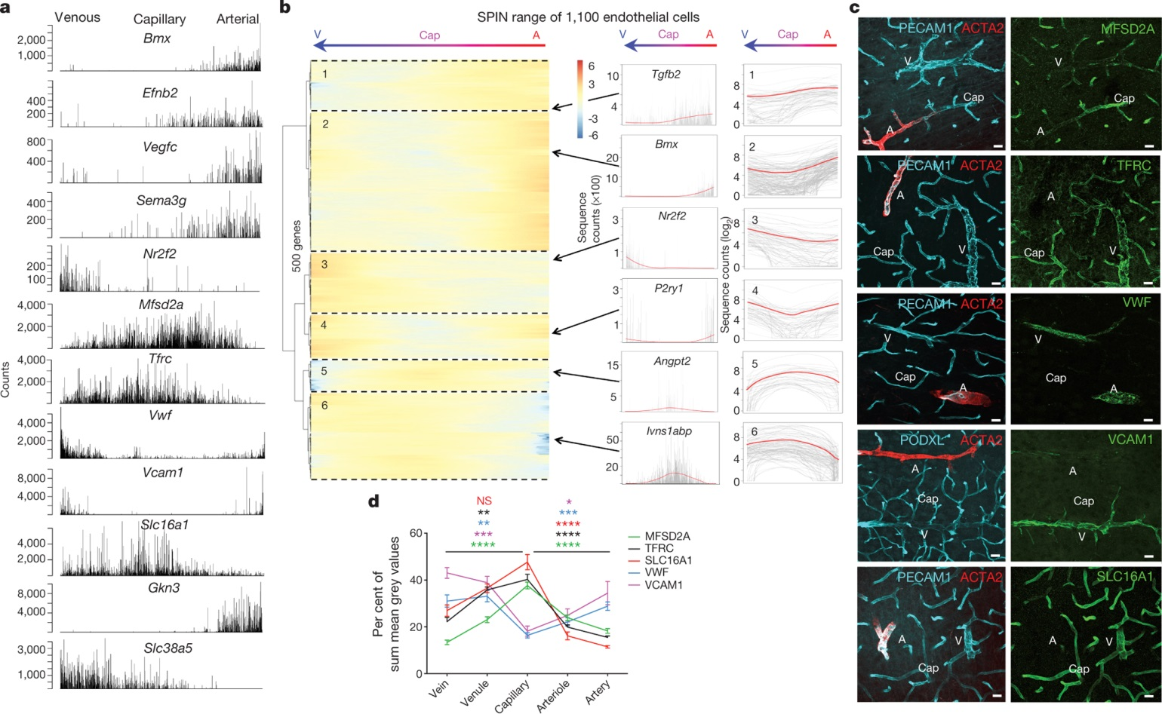
Endothelium Is The Unifying Principle Endothelial Zonation within Brain
M Vanlandewijck et al. Nature 554, 475–480 (2018) doi:10.1038/nature25739

Slide 13
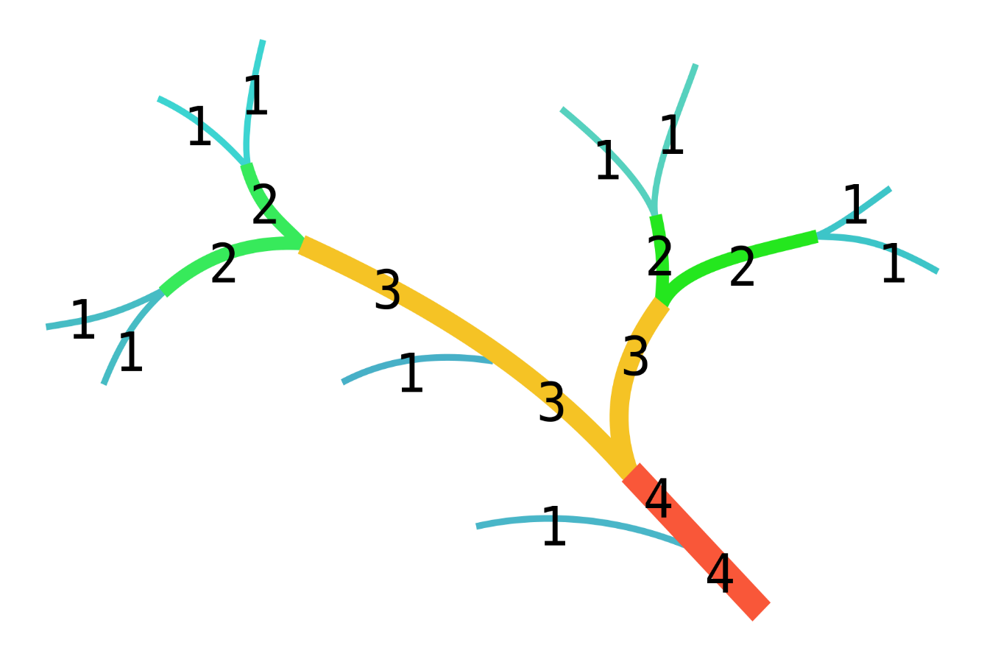
Metadata: Vascular Hierarchy Road System? “Tree of Life”?
Clinical: Large and medium size blood vessels have individual names and a recognizable hierarchy
Computational
https://radiopaedia.org/articles/cardiac-segmentation-model-1
blood supply of the thorax
arteries
thoracic aorta (development)
ascending aorta
aortic root
aortic annulus
coronary arteries
left main coronary artery
ramus intermedius artery
circumflex artery
obtuse marginal branches
left posterolateral branch
left anterior descending artery
diagonal branches
septal perforators
right coronary artery
conus artery
sinoatrial nodal artery
acute marginal branches
inferior interventricular artery (posterior descending artery)
right posterolateral branch
congenital anomalies
sinotubular junction
aortic arch
brachiocephalic trunk
common carotid artery
subclavian artery
vertebral artery
internal thoracic artery
musculophrenic artery
pericardiophrenic artery
superior epigastric artery
anterior intercostal arteries
thyrocervical trunk
inferior thyroid artery
suprascapular artery
ascending cervical artery
transverse cervical artery
dorsal scapular artery
costocervical trunk
supreme intercostal artery
deep cervical artery
axillary artery
variant anatomy
right-sided aortic arch
double aortic arch
ductus diverticulum
branching patterns
bovine arch
aberrant right subclavian artery
Example Radiopedia (https://radiopaedia.org)
https://commons.wikimedia.org/wiki/File:Flussordnung_(Strahler).svg#/media/File:Flussordnung_(Strahler).svg
Strahler number or Horton–Strahler number of a mathematical tree is a numerical measure of its branching complexity
Bifurcation ratio
Pathwidth

Slide 14
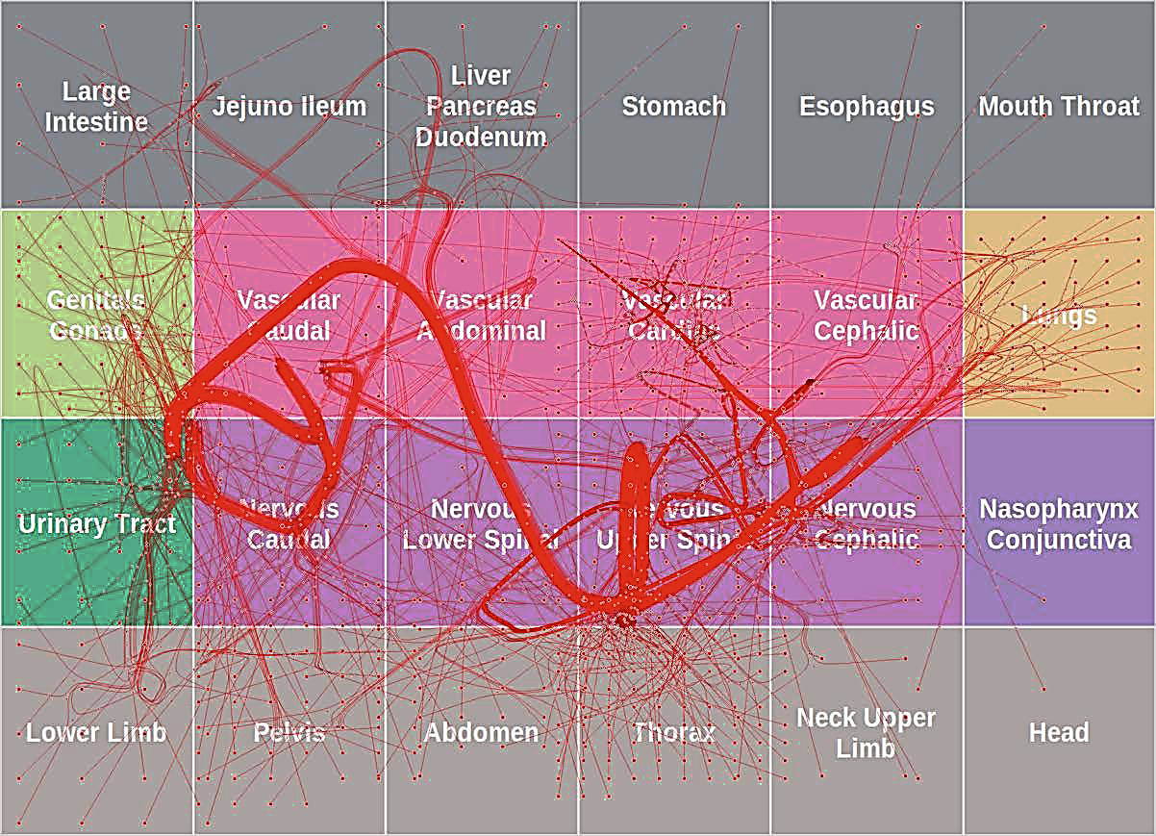
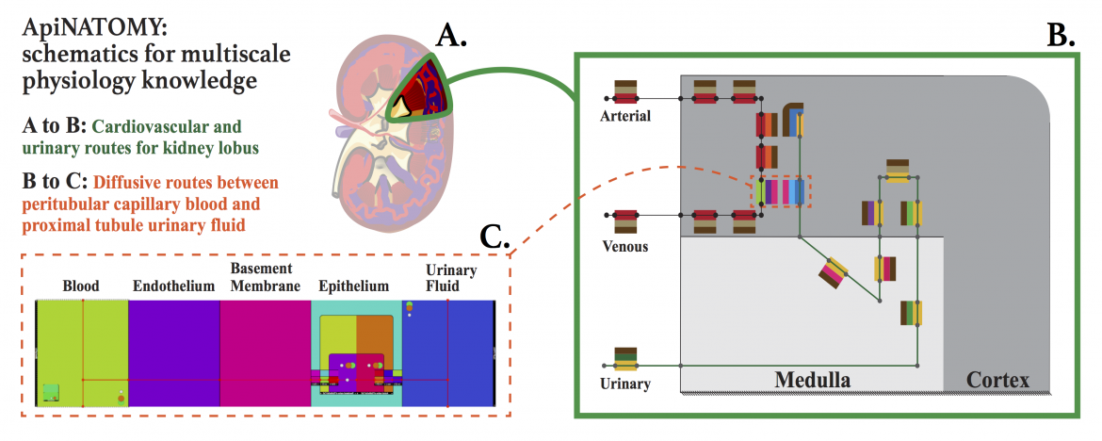
Vascular Conduits Functionally (and Structurally) “Wire” Together Same Organ’s Components and All Organs
ApiNATOMY
https://bivi.co/visualisation/apinatomy

Slide 15
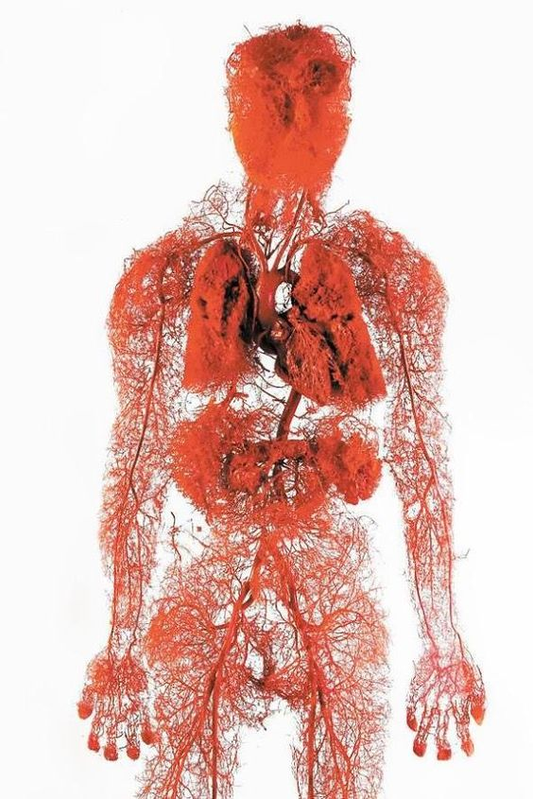
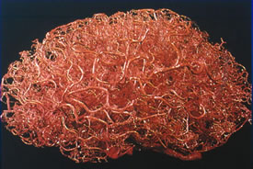
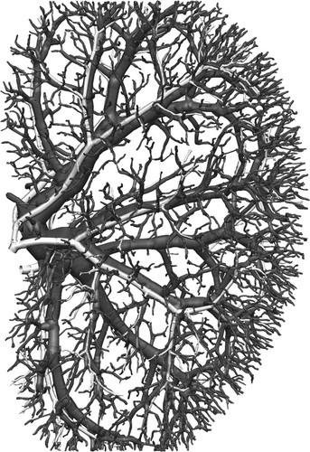
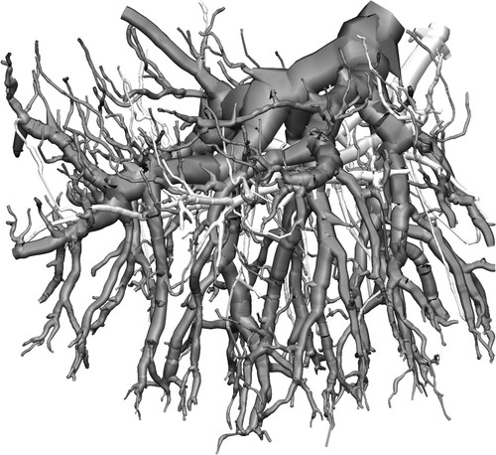
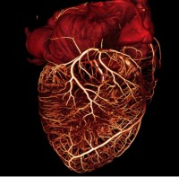
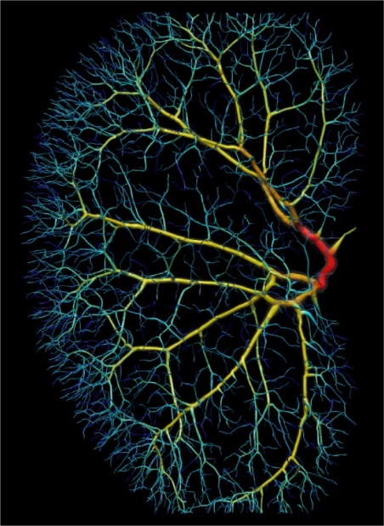
Desirable #2: “Applicable to all (most) body tissues” The Vasculature is “Framing” Organ’s Architecture - Across Scales
Zlokovic & Apuzzo: Neurosurgery 43(4):877-878, 1998
Riccio&Fenton/Cornell University
4 μm micro-CT data
20 μm micro-CT data
Nordsletten et al, 2006 Am J Physiol
Vessel order
https://www.pinterest.jp/pin/522699100479032485/

Slide 16
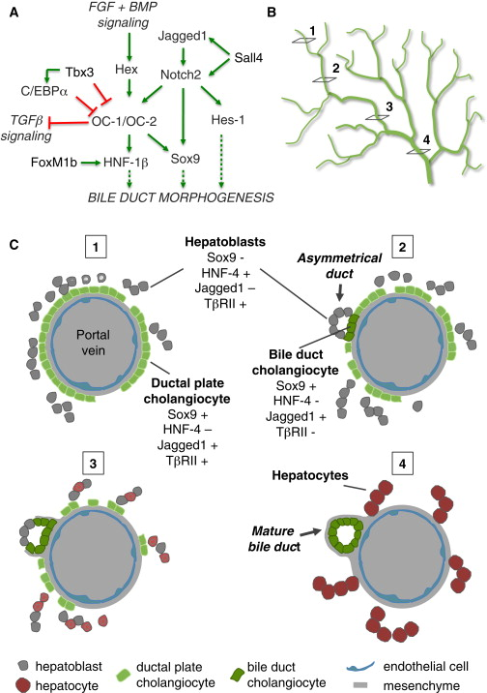
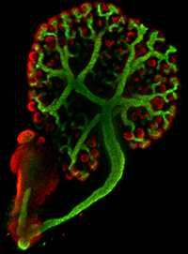
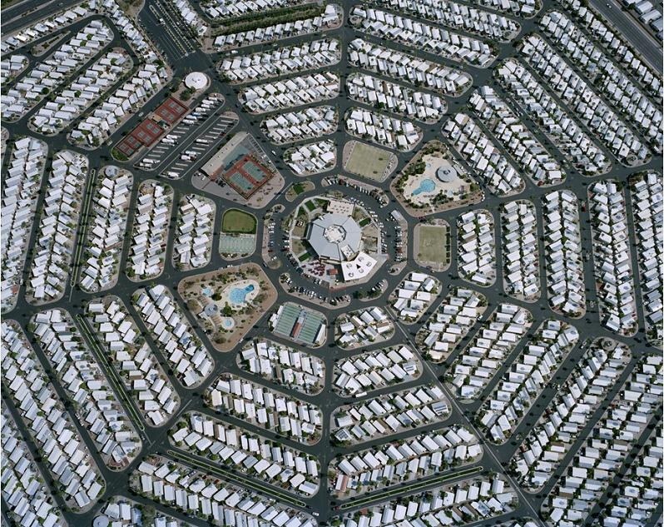
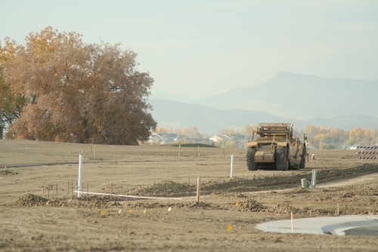
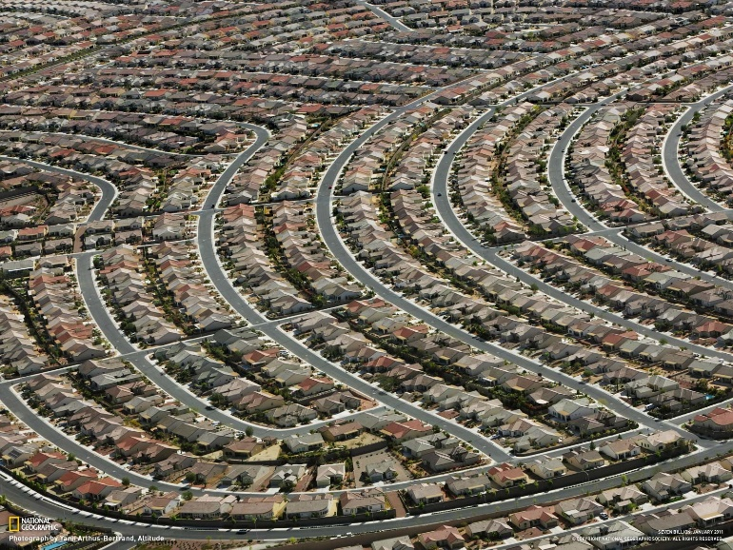
Vasculature Drives Organogenesis Organ Patterning Around Vessels
Development of Liver Bile Ducts
Roads in the Development of Residential Subdivisions
Si-Tayeb et al, Developmental Cell 2010

Slide 17
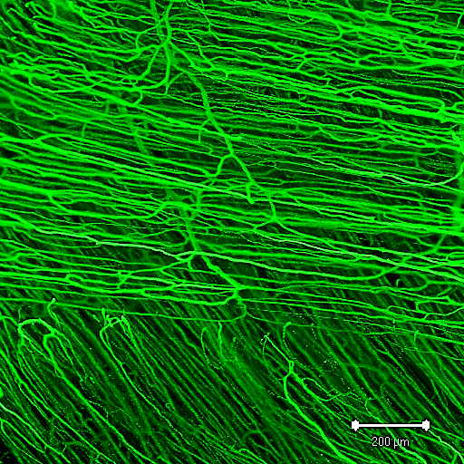
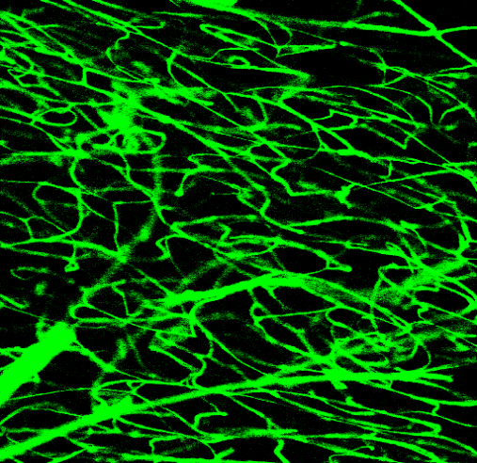
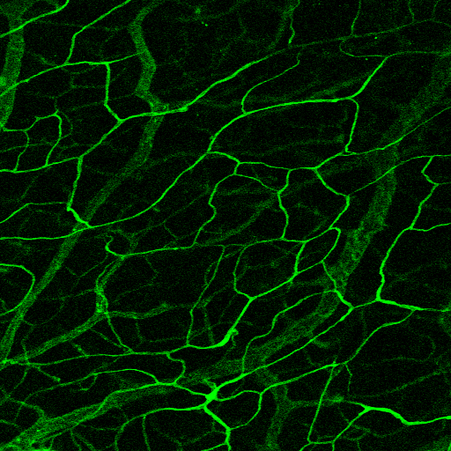
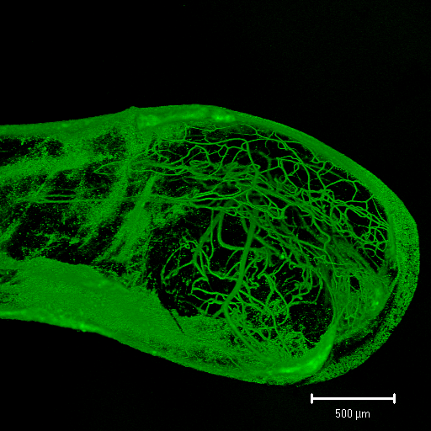
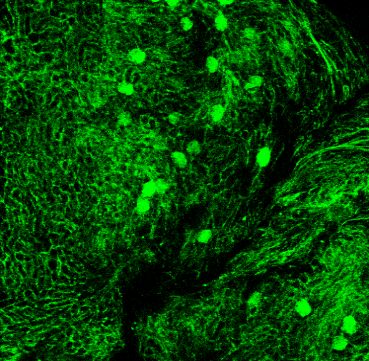



Vascular Architecture Provides Additional Recognizable Features Vascular “Fingerprint” for Each Tissue
Skeletal muscle
Brain
Intestinal Mucosa
Diseased vascular pattern
200 μm
200 μm
200 μm
Kidney
400 μm
Spleen
Intestinal Wall
200 μm
Experimental atheroma
400 μm
200 μm
(2-photon microscopy)
Glomerulus
Vessel order
Galis et al, JAHA 2016

Slide 18



Normal Vascular Fingerprints Change w/Ischemia and Disease
E.g., average vessel length, diameter, density
“Complexity” (branching)
Average Vessel Length (μm)
200 μm
Vessel Number
Blood vessels provide additional specific features that can be used to characterize tissues and register other cells (branching and other organizational pattern, diameter, relation to tissue edge, etc.)
Vessel Diameter (μm)
Matrix Metalloproteinase-9 Is Required for Adequate Angiogenic Revascularization of Ischemic Tissues,
2003 Circulation Research 94 (2), 262-268, DOI: (10.1161/01.RES.0000111527.42357.62)
©ZG2003
Galis et al 2006, Fingerprinting native and angiogenic microvascular networks through pattern recognition and discriminant analysis of functional perfusion data

Slide 19


Vascular Mapping by Machine Learning
http://DISCOtechnologies.org/VesSAP
Todorov et al, April 2019
https://www.biorxiv.org/content/biorxiv/early/2019/04/18/613257.full.pdf

Slide 20

Classifying Kidney Histology – AI?
“Do computers dream of electric glomeruli?”
https://www.kidney-international.org/article/S0085-2538(18)30173-X/pdf

Slide 21



Desirable # 3: “Accounts for donor differences (e.g., size, shape, sex)”
Vasculature Keeps Up With Individual Body Characteristics (Size, Shape, Sex etc.) and with Changes (Aging, etc.)
https://en.wikipedia.org
https://www.nationalgeographic.com/magazine/2019/01/visible-human-susan-potter-cadaver/
https://www.cafepress.com
Bodybuilding.com

Slide 22


Vessels Are Naturally Adapted To Body Characteristics
Main Vascular Conduit: The Aorta
Lung
Modeling Lung Architecture in the XCAT Series of Phantoms: Physiologically Based Airways, Arteries and Veins, Abadi, E et al, IEEE Transactions on Medical Imaging (37), Issue 3, March 2018, 693-702
https://ieeexplore.ieee.org/stamp/stamp.jsp?arnumber=8094255
https://www.karger.com/Article/FullText/381281

Slide 23


Vascular Fingerprinting: individual variations are likely but not necessary functionally consequential
Retinal vessel measurement by IVAN software: image and splats display showing relatively larger arterioles (CRAE 183.62 μm) and venules(CRVE 251.12 μm) and an AVR (0.73). Arterioles in red and venules in blue
Proposal:
Individual structural variations with no tissue-level or clinical phenotype represent tissue adaptations > we can assume these represent “normal” variations and will not significantly impact mapping of tissue, including vasculature
Yet, functional deviations from “normal” (average?) patterns can be diagnostic

Slide 24



Desirable #4: “Useful/Acceptable across specialty domains”
Clinical Domain: Blood vessels used as organ landmarks and conduits (e.g. for surgery, biopsy) and indicators of normal structure and function (diagnostic)
Blood vessels are used clinically as organ and tissue landmarks for surgery
Tissue vascularization patterns are used clinically to diagnose diseases
Diabetic Retinopathy
https://path.upmc.edu/cases/case172/micro.html
https://slideplayer.com/slide/4585491/
Pancreatic tumor

Slide 25





Of Watersheds and Vascular Territories
Nile Delta watershed
Nile Delta at night
https://www.louisberger.com/our-work/project/anacostia-river-watershed-restoration-plan-washington-dc-us
http://www.dailymail.co.uk
Nile Delta Population
wikipedia.org
Every cell in the human body lives within the watershed of an artery
Many arteries have their own names, already familiar to medical professionals, and are clinically used (e.g., as landmarks, diagnostic, access)
The concept of vascular territories is known and used clinically

Slide 26


The Concept of VASCULAR TERRITORIES (“Angiosomes”) Macro <>Meso Scale
Serendipity?
“Vascular territories” demarcate areas that are supplied by specific arteries.
First introduced in relation to practicing plastic surgery (e.g., for skin flaps)
Currently used for clinical interventions targeting internal organs (e.g., heart, liver, brain, etc.) and limbs
HuBMAP
Taylor GI, Ives A, Dhar S. Vascular territories.
In: Mathes SJ, editor. Plastic surgery. 2nd edition, vol. 1. Philadelphia: Elsevier; 2006

Slide 27



Example Clinical Applications of Vascular Territories
Clinical application (internal organ): liver surgical resection
Clinical application: Limbs
Targeted Revascularization in Diabetic Critical Limb Ischemia (CLI)
Anatomy of the liver: An outline with three levels of complexity – A further step towards tailored territorial liver resections
Majno et al, Journal of Hepatology 2014 vol. 60 j 654–662. Illustrations of the 3rd level of complexity: different representations of vascular territories are resolved in the 1-2-20 concept.
https://www.ncbi.nlm.nih.gov/pmc/articles/PMC3180522/
Alexandrescu and Hubermont

Slide 28




Vasculature of the Kidney Going across Scales: Macro<>Meso<>Micro
From 20 μm micro-CT data
From 4 μm micro-CT data
Color is an indicator of the vessel order
Structural Morphology Of Renal Vasculature. Nordsletten Et Al, 2006 Am J of Physiology
http://www.physiology.org/doi/full/10.1152/ajpheart.00814.2005
https://onlinelibrary.wiley.com/doi/full/10.1111/bju.13788
Macchi et al 2017 Urological Oncology

Slide 29




Tissue Vascular Relationships Mammalian Kidney Meso<>Micro Scale
Kidney Histology: Endothelial cells (EC) staining (PECAM-1 Staining)
Protein Atlas https://www.proteinatlas.org/ENSG00000261371-PECAM1/tissue/kidney#img
(NOTE: 100 μm!)
Meso
PECAM-1
Bankir https://www.theisn.org/news/item/1464-vascular-tubular-relationships-in-the-mammalian-kidney
Micro
100 μm
100 μm
Close-up
Kidney Corpuscule (glomerulus)
https://en.wikipedia.org/wiki/Glomerulus_(kidney)#/media/File:Renal_corpuscle-en.svg

Slide 30


Vascular Patterns As Reference For Tissue Location, Normal Vs. Diseased
Detecting Blood Vessels In Kidney Histological Sections
Pattern of vascularity is a marker for tissue location
Frozen sections of mouse kidney were labeled to accentuate the endothelium (CD31, red) and counterstained to show F-actin (Phalloidin, green microvilli) and nuclei (Hoechst’s dye, blue).
In cortex, the vasculature is located within the glomerulus (G) and surrounding the tubules (PT, proximal tubules). Occasional large arteries (A, like the arcuate or interlobular) are also visible. In the inner medulla, the vasa recta are packed very densely surrounding the collecting ducts and loops of Henle.
Size bar = 50 microns.
(from: Unwrapping the origins and roles of the renal endothelium, Beer Stolz&Sims-Lucas. Pediatr Nephrol. 2015 Jun; 30(6): 865–872)
Pattern of vascularity is a marker for normal or diseased tissue
Serial sections of a normal kidney tissue, a low-grade CCRCC, and a high-grade CCRCC stained with CD31 endothelial marker
Xin Yao et al. Clin Cancer Res 2007;13:161-169
http://clincancerres.aacrjournals.org/content/13/1/161

Slide 31

Location, Location, Location Diverse Endothelial Cell Populations Associate With Different Cells of The Kidney
Vascular Neighborhoods:
EC types can be used as reference to localize other cell types within the same tissue/organ
Endothelium structure and function in kidney health and disease, Jourde-Chiche et al., Nature Reviews Nephrology (15), 87–108 (2019)
https://www.nature.com/articles/s41581-018-0098-z/figures/3
Notes:
The kidney harbors three main populations of endothelial cells with distinct architectures and functions. Endothelial cells within medium and large vessels are continuous, confluent, connected by intercellular junctions and elongated in the direction of blood flow. Glomerular endothelial cells are highly fenestrated and are covered on their luminal surface by a thick glycocalyx, which participates in the sieving properties of the glomerular filtration barrier. Crosstalk between glomerular endothelial cells, mesangial cells and podocytes is crucial for the maintenance of glomerular structure and function. Similar to glomerular endothelial cells, endothelial cells of the peritubular capillaries are also fenestrated, and their fenestrae are covered by a thin diaphragm composed of glycoproteins. This endothelial population facilitates the reabsorption and secretion of fluids and molecules from the adjacent tubular epithelial cells.

Slide 32

Vasculature as CCF and Road Map for the Body: What would a potential (road map) address for a SC in the kidney look like?
E.g., Could we come up with something like?
Main Location (Kidney): “RA” (renal Artery)
Addresses downstream from Afferent Arteriole (order=1): “RA-1”
An endothelial cell in the afferent arteriole: RA-1-00 (EC of thatsame vascular structure)
A myocyte in afferent arteriole: RA-1-01 (next rows RA-1-02, RA-1-03)
A capillary (endothelial cell) within the glomerulus “RA-1-0-00”
Single kidney cell position in relation to the closest capillary (order= 0): could use actual distance (or fractions of the “golden” 100 μmeter distance), or even a row number for the cell, e.g., first cell next to a capillary “RA-1-0-01”, next RA-1-0-02, etc.
RA-1-01
RA-1-00
RA-1-0-02
RA-1-0-01
4
RA-1-0-00
3
Important points:
Leverage existing knowledge of organ architecture and function. Many organs have a readily recognizable organizational pattern, including of the associated vasculature.
Verify tissue has “normal” appearance by pathological examination (macro and micro)
Visually document histology of sample (e.g., fiduciary markers, histology)
Establish and use conventions regarding numbering and recoding closest vascular order, cell rows, etc.
2
1
1
0
Strahler number
Artery order (4>>0) can be assessed at macro and microscale (see kidney intro slide)

Slide 33


Tissue Organization/Pattern
Utility of a 100 μmeter “tissue-stick”?
Colon Histology
PECAM1 (CD31) staining
(Endothelial Cells)
Kidney Histology PECAM-1 Staining
(EC, endothelial cells)
100 μm
100 μm
100 μm
Protein Atlas
https://www.proteinatlas.org/ENSG00000261371-PECAM1/tissue/colon#img
Protein Atlas
https://www.proteinatlas.org/ENSG00000261371-PECAM1/tissue/kidney#img
Close-up:
Kidney Corpuscule (glomerulus)
33

Slide 34


Tissue Oxygenation Gradients The functional importance of the 100 μmeter
Oxygen PO2 profile in the immediate vicinity of the arterioles in the rat mesentery
Fitting of these data to the oxygen profile deduced by solving the diffusion equation shows that the medium beyond the blood/tissue interface must be divided into two zones with significantly different rates of oxygen consumption, where the outside of the vessel wall rate is two orders of magnitude higher than the remainder of the tissue. The shaded area represents the portion of the tissue that is occupied by the vessels wall. [Data from Tsai et al.]
Each tissue has specific microvascular architecture
Each tissue has specific oxygen gradients, capillary distance and metabolic activity.
Normal gradients are significantly affected by pathological situations
DOI: (10.1152/physrev.00034.2002)

Slide 35


Tissue Oxygen Tension (Tpo2) Values Measured In Different Organs In Different Species
BJA: British Journal of Anaesthesia, Volume 115, Issue 3, 21 July 2015, Pages 357–365, https://doi.org/10.1093/bja/aev162
Notes:
Fig 1 Tissue oxygen tension (tPO2) values measured in different organs in different species. Only studies in which the inspired O<sub>2</sub> fraction was reported to be 0.21 are included. Ranges for human brain PO2 are reported as 3.4 (sd 0.2) kPa,<sup>2</sup> for muscle 3.8 (0.8) kPa,<sup>3</sup> for skin 7.2 (3.3) kPa, and for liver either 6.1 (5.8)<sup>4</sup> or 4.1 (range 2.6–5.4) kPa.<sup>5</sup>
Unless provided in the caption above, the following copyright applies to the content of this slide: © The Author 2015. Published by Oxford University Press on behalf of the British Journal of Anaesthesia. All rights reserved. For Permissions, please email: journals.permissions@oup.com
35

Slide 36

Intracellular Oxygen Sensing: HIF-alpha Inducible Genes
Intracellular oxygen sensing and erythropoietin production
The cellular response to hypoxia is controlled by a family of transcription factors, known as hypoxia-inducible factors (HIFs). In the presence of normoxia, HIFα is rapidly destroyed. Under conditions of tissue hypoxia, the proteasomal degradation of HIFα is slowed, resulting in its cytoplasmic accumulation and subsequent translocation to the nucleus, where it dimerizes with HIFβ and enhances the transcription of the Epo gene.
From Patnaik MM, Tefferi A 2009. Leukemia 23:834–844

Slide 37



Kidney Arterial Vasculature and Oxygenation
The vascular patterns of the cortex and the three zones of the medulla are distinctly different
Experimental Detection of Hypoxia
Kidney Medulla
Potential strategy for using hypoxia fingerprint to increase precision of SC localization based on distance from vasculature
Measure induction/expression gradients of hypoxia-inducible genes in various cell clusters - likely to be organ/tissue and cell type specific
Image hypoxia
http://site.hypoxyprobe.com/images/Hypoxia-in-rat-kidney-outer-medulla.jpg
Imaging Hypoxia References http://www.hypoxia-imaging.org/references.htm
Koch CJ (2002) Measurement of absolute oxygen levels in cells and tissues using oxygen sensors and 2-nitroimidazole EF5. Methods in Enzymology 352: 3-31 - Sigma EF5 Hypoxia Detection Kit (immunofluorescence)
Pimonidazole HCl (Hypoxyprobe-1) See http://www.hypoxyprobe.com/hypoxyprobe-products.html
HIF responsive genes: JMJD1A, VEGF, GLUT1, EPO, HK1 levels (Note: additional pathways are controlling expression)
Expression involucrin and carbonic anhydrase IX (Br. J. Cancer, 90: 728-735, 2004)
Rat kidney filled with Microfil. Longitudinal section
Bankir https://www.theisn.org/news/item/1464-vascular-tubular-relationships-in-the-mammalian-kidney

Slide 38





There is more…Vasculature of Various Organs Examples and Considerations

Slide 39
Vasculature as CCF and Road Map for the Human Body
Vascular system is used by the body to reach and sustain every cell. Adapted to individual variations, tissue specific characteristics and needs, etc. Microvasculature is integrated in all tissues and organs. Maximum distance from any given cell to a vascular source of O2 is ~100 um, depending on tissues (much less in tissues with high energy requirements represents, e.g., heart) ~ within a few single cell range. Opportunity to identify tissue and place cells based on their oxygen-dependent gene expression.
Vasculature provides body wide integration: one contiguous endothelial cell (EC) lining for all blood vessels throughout the body, from the largest to the smallest vessel (one cell thick), with many local structural/functional variations
Smooth transition across scales: contiguous variation from whole body size (e.g. aorta) to smallest single cell vessel (i.e., capillary= one endothelial cell thick)
Whole body CCF and/or Specific organ CCF - vasculature mapping can work for all organs, or can be integrated with local/organ-specific CCF. Various body organs can be positioned in relation to each other based on how their main blood/oxygen conduit branches off the main vessel (aorta)
A large amount of previous knowledge about vasculature is already used clinically: opportunity to leverage existing anatomical, clinical ontologies, imaging modalities, data, anatomo/pathological characterization, phenotypes, etc.

Slide 40
Leveraging Vasculature for Single Cell Level Considerations
Potential strategies to leverage vasculature characteristics for CCF:
Building a “road map” approach, seamlessly connecting macro <> meso <> micro vascular scales, e.g., develop rules that allow assigning addresses for individual cells based on their localization in relation to vasculature territory/hierarchy, all the way to capillaries
identify and reconstruct cell location based on relation to blood vessel hierarchy in samples (macro organ/tissue sample and histological specimens).
Assign individual cell addresses based on the vascular territory and the most proximal vascular structures (hierarchy), neighborhoods to which they belong
Developing a “GPS approach” based on expression profiles in various SC analyses, e.g.,
identify EC type (gene expression, “zip codes”) and oxygenation-driven signals in various samples
use signals to anchor and align other SC within the tissue map, to be added and confirmed with structural information and known patterns
These two main approaches are complementary and can be used iteratively to confirm each other and increase precision

Slide 41



Getting there…
1966
2016 Nobel Chemistry: Nano-Machines

Slide 43

Some Bio-numbers Freitas, Nanomedicine, Volume I: Basic Capabilities
Most human cells fall within a size range of 2-120 microns.⁸⁶⁶ Platelets are ~2 microns, red cells ~3 microns x ~8 microns, neutrophils ~8-10 microns, lymphocytes ~6-12 microns in size, exocrine cells ~10 microns, fibroblasts 10-15 microns, osteocytes ~10-20 microns including processes, chondrocytes and liver cells ~20 microns, goblet and ciliated cells ~50 microns long and 5-10 microns wide, macrophages at ~20-80 microns, hematopoietic stem cells ~30-40 microns, and adipocytes filled with stored lipid are typically 70-120 microns in diameter (but may be up to five times larger in very obese people).^{935,936} Neurons vary enormously in size and shape, their bodies ranging from 4-120 microns in diameter with axonal processes varying between ~0.1-20 microns in diameter and ranging in length from a few microns up to ~1 meter;⁷⁹⁹ muscle cells (~30% of all tissue cells) also vary from 10-100 microns in diameter and may run up to ~50 cm in length. However, the "average" tissue cell, if such a thing may be said to exist, is probably ~20 microns in diameter,³¹³ weighing ~10 nanograms.
mean tissue cellular number density ~125 million cells/cm³.
http://www.nanomedicine.com/NMI/Tables/8.9.jpg

Slide 44

Some Bio-numbers: The Human Vascular System
http://www.nanomedicine.com/NMI/Tables/8.1.jpg

Slide 45
Vessel Network Analysis Tools and Microvascular Architecture Models
Name | Lang. | Application | Metrics | Validation | Cts | Yr | Cts/yr
AngioQuant83 | MATLAB | Brightfield, Cell Culture | Segment Count, VL, VA, VAF, Segment Area, BP, BP/Segment Count | QT BD | 104 | 2005 | 8
RAVE81 | MATLAB | Fluorescent, Tissue | VAF, VLD, VR, FD | QT manually analyzed BD for VAF, VLD, and VR. Basic In silico for FD | 24 | 2011 | 3.4
Vessel Analysis ImageJ Macro | ImageJ Macro | Brightfield, Tissue | VAF, VLD | None | ‐ | ‐ | ‐
AngioTool78 | Java, ImageJ | Fluorescent, Tissue | VAF, SC, VL, VLD, EP, lacunarity, BP/area | QL manually analyzed BD | 111 | 2011 | 15.9
CSAQ282 | Web Based | Brightfield, Tissue | VL, VAF, BP; Contrast, Entropy | Manual (BP), QT comparison to AngioQuant | 24 | 2008 | 2.4
Breast Tumor Microvasculature Reconstruction82 | MATLAB, JAVA | Micro Ct, Tumor | VLD, VD, SL, MEVDD, FD, Tortuosity, Flow | Metrics from BD within literature values | 17 | 2013 | 3.4
VESGEN 2D283 | Java, ImageJ | Brightfield/ Flourescence, Tissue | VD, VT, FD, VAF, VLD, BP | QT BD | 29 | 2009 | 3.2
Description | Language | Method | Type | Validation
Particle‐based EC Network284 | C++ | ABM, CPM | Vasculogenesis | QT to classic CPM
Retina ABM285 | NetLogo | ABM | Retinal developing vasculature | QT comparison retinal BD
3D CPM of Tumor Growth286 | CompuCell3D | ABM, CPM | Tumor angiogenesis | QL to Macklin et al.287
ABM for Disruption of Vasculogenesis288 | CompuCell3D | ABM | Vasculogenesis | QT to BD with AngioTool78
3D Sprouting Angiogensis289 | NS | ABM | Sprouting angiogenesis | QT metrics within BD range
Hypoxic Vessel Sprouting290 | NS | ABM Hybrid | Any 2D or 3D vessel formation in a tissue | QT comparison with BD
Tumor Angiogenesis and Patterning291 | NS | ABM Hybrid | Sprouting angiogenesis | QT metrics within BD range
Angiogenesis with Discrete Random Walks292 | NS | ABM Hybrid | Tumor angiogenesis | QL assessment of simulation results
ABM of Tumor Angiogenesis and Regression²⁹³ | NS | ABM Hybrid | Tumor angiogenesis and regression | QL to BD
3D Phase Field ABM of Vascular Networks²⁹⁴ | NS | ABM Hybrid | 3D Angiogenesis | QL to basic theoretical behavior
Adaptive Network with Flow²⁹⁵ | C | Stochastic Hybrid model | Flow, oxygen transport, and adaptation of existing network | Thorough quantitative comparison to experimental results across all categories
Multiphase Tumor Angiogenesis Growth²⁹⁶ | CAST3M | Continuum Discrete | Tumor growth | QT comparison with BD
Vessel Generator for Cell‐colocalization (CIRCOAST)135 | MATLAB | Structural Descriptive Model | Static adult microvascular network for basic model validation | QT metrics within BD range
Tumor Angiogenesis with Blood and Interstitial Flow²⁹⁷ | NS | Hybrid | Tumor growth | QT metrics within BD range
BD, biological data; BP, branchpoints; EP, endpoints; FD, fractal dimension; MEVDD, max extra‐vascular diffusion distance; NS, not specified; QL, qualitative; QT, quantitative; SC, segment count; SL, segment length; VLD, vessel length density; VD, vessel diameter; VR, vessel radius.
https://onlinelibrary.wiley.com/doi/full/10.1111/micc.12520

Slide 46
The KIDNEY: Artistic Rendition of Kidney Vasculature
See a quick video of arterial supply of the kidney
https://youtu.be/FYVv6GXlDFA
http://editthis.info/biol557/Chapter_26_notes_(Renal)

Slide 47
Experimental Detection of Hypoxia
Imaging Hypoxia
http://www.hypoxia-imaging.org/references.htm
https://www.researchgate.net/publication/6265185_The_Potential_Role_of_Intrinsic_Hypoxia_Markers_as_Prognostic_Variables_in_Cancer
Koch CJ (2002) Measurement of absolute oxygen levels in cells and tissues using oxygen sensors and 2-nitroimidazole EF5. Methods in Enzymology 352: 3-31 - Sigma EF5 Hypoxia Detection Kit (immunofluorescence)
Pimonidazole HCl (Hypoxyprobe-1) See http://www.hypoxyprobe.com/hypoxyprobe-products.html
HIF responsive genes: JMJD1A, VEGF, GLUT1, EPO, HK1 levels (Note: additional pathways are controlling expression)
Expression involucrin and carbonic anhydrase IX (Br. J. Cancer, 90: 728-735, 2004)
Hypoxia In The Kidney Medulla
http://site.hypoxyprobe.com/images/Hypoxia-in-rat-kidney-outer-medulla.jpg
Potential strategy for using hypoxia fingerprint to increase precision of SC localization based on distance from vasculature
Measure induction/expression gradients of hypoxia-inducible genes in various cell clusters - likely to be organ/tissue and cell type specific
Image hypoxia

Slide 48
CCF meeting CZI-NIH Summary December 11-12, 2017
Integration across scales:
(1) the “gross”/macroscopic scale, which is the anatomical view of the organs and body systems linked by the vasculature;
(2) the fine scale, which encompasses the microscopic view of the human body at the histologic and cellular level; and
(3) the mesoscale, a transitional point between the microscopic level, where individual variation is prominent, and the macroscopic level, where a more stable species stereotypy is observed
CCF meeting CZI-NIH (Dec 2017)

Slide 49
CCF meeting CZI-NIH Summary December 11-12, 2017
Tissue/Specimen Original Location (surgical or autopsy)
Metadata desirable: text labels, photographic images of the sampling sites, and some type of diagrammatic annotation
Language reconciliation of anatomical vocabulary with biological vocabulary within the CCF
Tools: find the right balance between structured information and free text, and between minimal and complete data

Slide 50
CCF meeting CZI-NIH Parting Thoughts December 11-12, 2017
General agreement: no one strategy of mapping will work for all systems and scales. Instead, the CCF could be viewed as a sequence of triage in events with relatively coarse positional information on larger structure and higher-resolution for local architecture
An iterative approach there may be at first development of multiple individual CCF systems for specific organs that will be linked with a hierarchical overarching description or physical map
As an alternative approach, meeting participants discussed using blood vessels to provide a common reference for different organs and major body systems at the gross scale (see presented slides in the Addendum)
Although inter-individual variability of the vasculature exists, major vascularization of the organs is both stereotypical and recognizable at the histologic level.
Use of blood vessels as a common reference to link different organs in the CCF offers an additional advantage because surgical resection is performed according to blood vessel location.
Therefore, information on the positional information of specimens relative to blood vessels is likely to be easily obtained at the point of specimen collection
CCF meeting CZI-NIH (Dec 2017)

